Slide 1
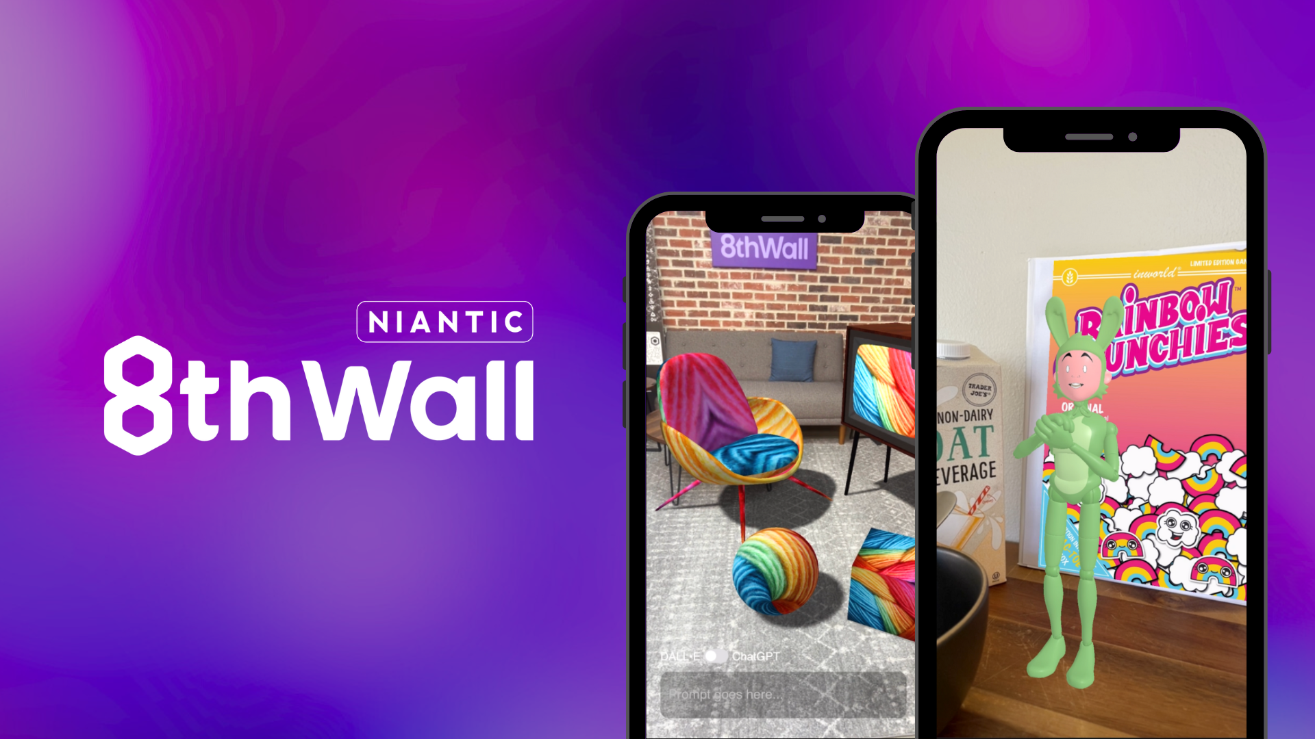
=

Slide 2
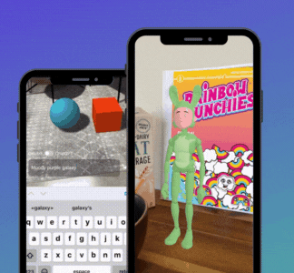
Quickly unleash WebAR’s full potential with New GenAI Modules
Generative AI (GenAI) Modules for 8th Wall allow developers, brands, and agencies to quickly connect to powerful tools like Inworld AI and OpenAI with no server setup required.
Inworld AI Integration Module: Seamlessly add emotionally intelligent, lifelike characters to WebAR experiences that adapt, engage, and provide context-aware responses.
8th Wall Integration Module for OpenAI: Give end-users more control with rich, interactive WebAR experiences built on DALL-E and ChatGPT.
Hassle-Free Setup: Just add either GenAI Module to your project, plug in your API key and you're all set. No server setup or token management needed!
Notes:
Need more assets for emailing or sharing with clients? View the drive here for a collection of GIFs and videos.

Slide 3
Ideas for building with GenAI and 8th Wall - Inworld AI
Want help getting started building with GenAI and 8th Wall? Below see sample use cases and recipes for building 8th Wall experiences with Inworld AI.
Image Targets + Inworld AI: Use Image targets to launch a character experience. This could be on the pack of packaging, in an inline advertisement, on a billboard, or even from a holiday card.
Sky Effects + World Tracking + Inworld AI: Have characters appear in the sky and land in front of the user and natural engage with the world around them. At a sporting event, have a mascot jump over the endzone or for a holiday promotion have Santa fly down from the sky.
Lightship Maps + Lightship VPS + Inworld AI: Position characters at spots in the real-world and use Lightship VPS to localize and jump-start an experience. Combined these tools could be used for an interactive Tour Guide or educational experience.
Inworld AI + ReadyPlayerMe: Don’t have a mascot or character? Combine Inworld AI with ReadyPlayerMe to create your own unique character for an experience.

Slide 4
Ideas for building with GenAI and 8th Wall - Open AI
Want help getting started building with GenAI and 8th Wall? Below see sample use cases and recipes for building 8th Wall experiences built on OpenAI tools like DALL-E and ChatGPT
Image Targets + DALL·E: Let users guide experiences by changing empty space or empty frame with artwork generated in real time.
World Tracking + DALL·E: Create an evolving experiences with by letting users generate textures with DALL·E and overlay them on a 3D object in the scene.
Face Effects + DALL·E: Let users harness DALL·E to create personalized one-of-a- kind face filters based on their input.
Lightship VPS + DALL·E: Use DALL·E to generate a texture and use Lightship VPS to tie the texture to the physical world with centimeter-level accuracy.
Use ChatGPT to support development: Give ChatGPT the parameters or your basic project and ask it to generate code that can be applied to your a-frame or three.js project.

